Slide 1
RAINFALL PREDICTION USING ARIMA AND LINEAR REGRESSION MODEL
BATCH:- A12
DOMAIN:- Machine Learning
NAME:- Supriya.S (211418104275)
Surya.P (211418104278)
Swetha. N (211418104284)
GUIDE NAME:- Dr.K.Sangeetha

Slide 2
ABSTRACT
Rainfall forecasting is very important because heavy and irregular rainfall can have many impacts like destruction of crops and farms, damage of property so a better forecasting model is essential for an early warning that can minimize risks to life and property and also managing the agricultural farms in better way.
The proposed scheme provides annual rainfall prediction and four seasonal rainfall predictions such as summer, autumn, rainy, and winter.
The ARIMA trained on 1400 epoch for revealing very good results. Linear regression is acted as the best optimizer.
The ARIMA model revealed better accuracy in all of the seasonal and annual rainfall.
We use the real data from Indian government website https://data.gov.in/ and compare the model quality based on several criteria in ARIMA.

Slide 3
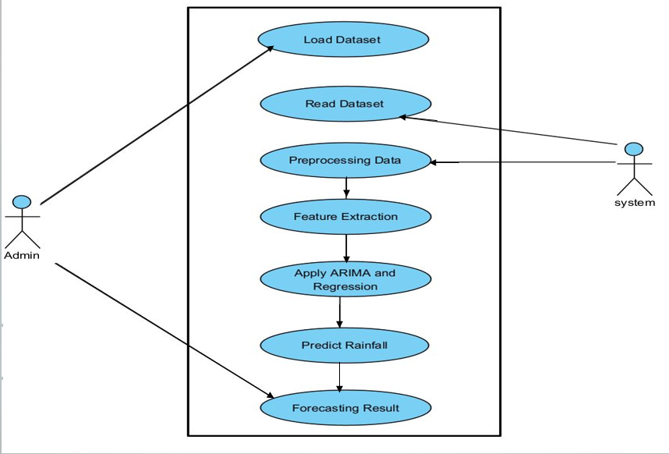
SYSTEM DESIGN - USECASE DIAGRAM

Slide 4
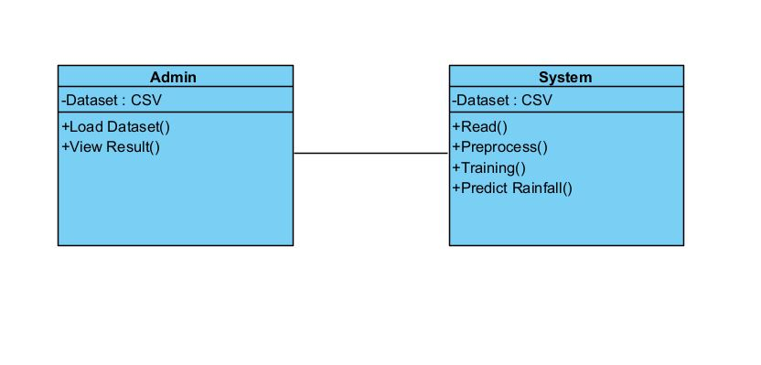
CLASS DIAGRAM

Slide 5
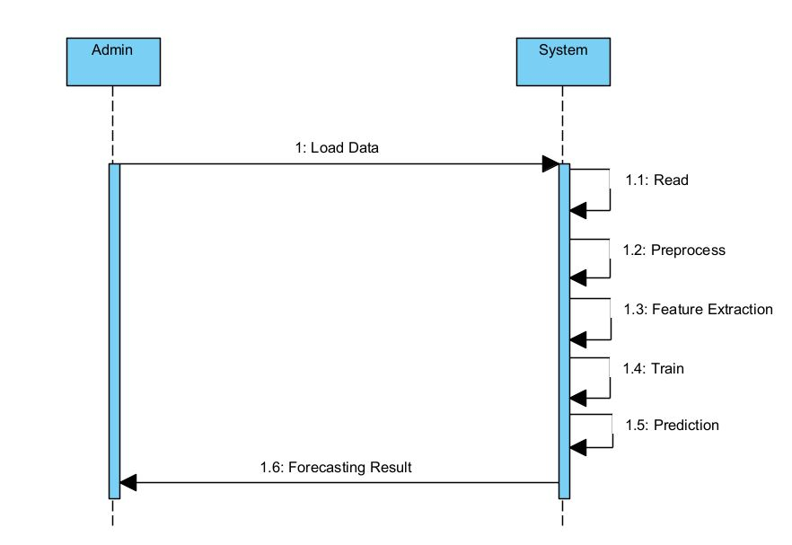
SEQUENCE DIAGRAM

Slide 6
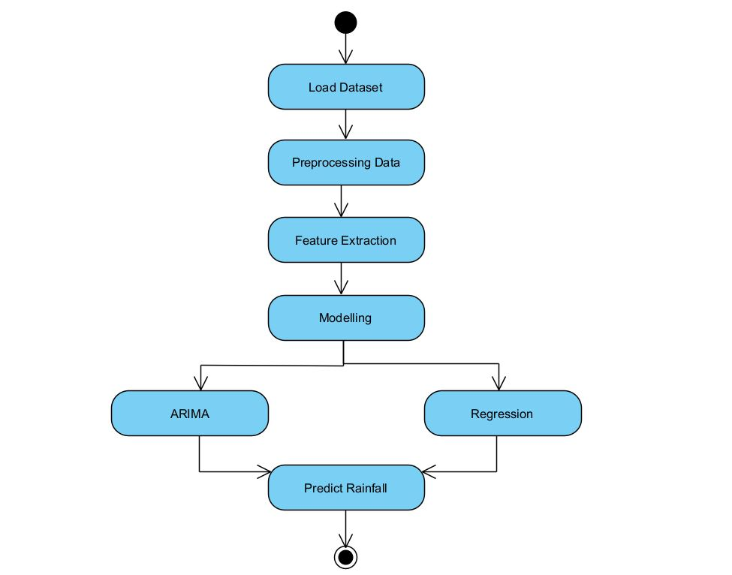
ACTIVITY DIAGRAM

Slide 7
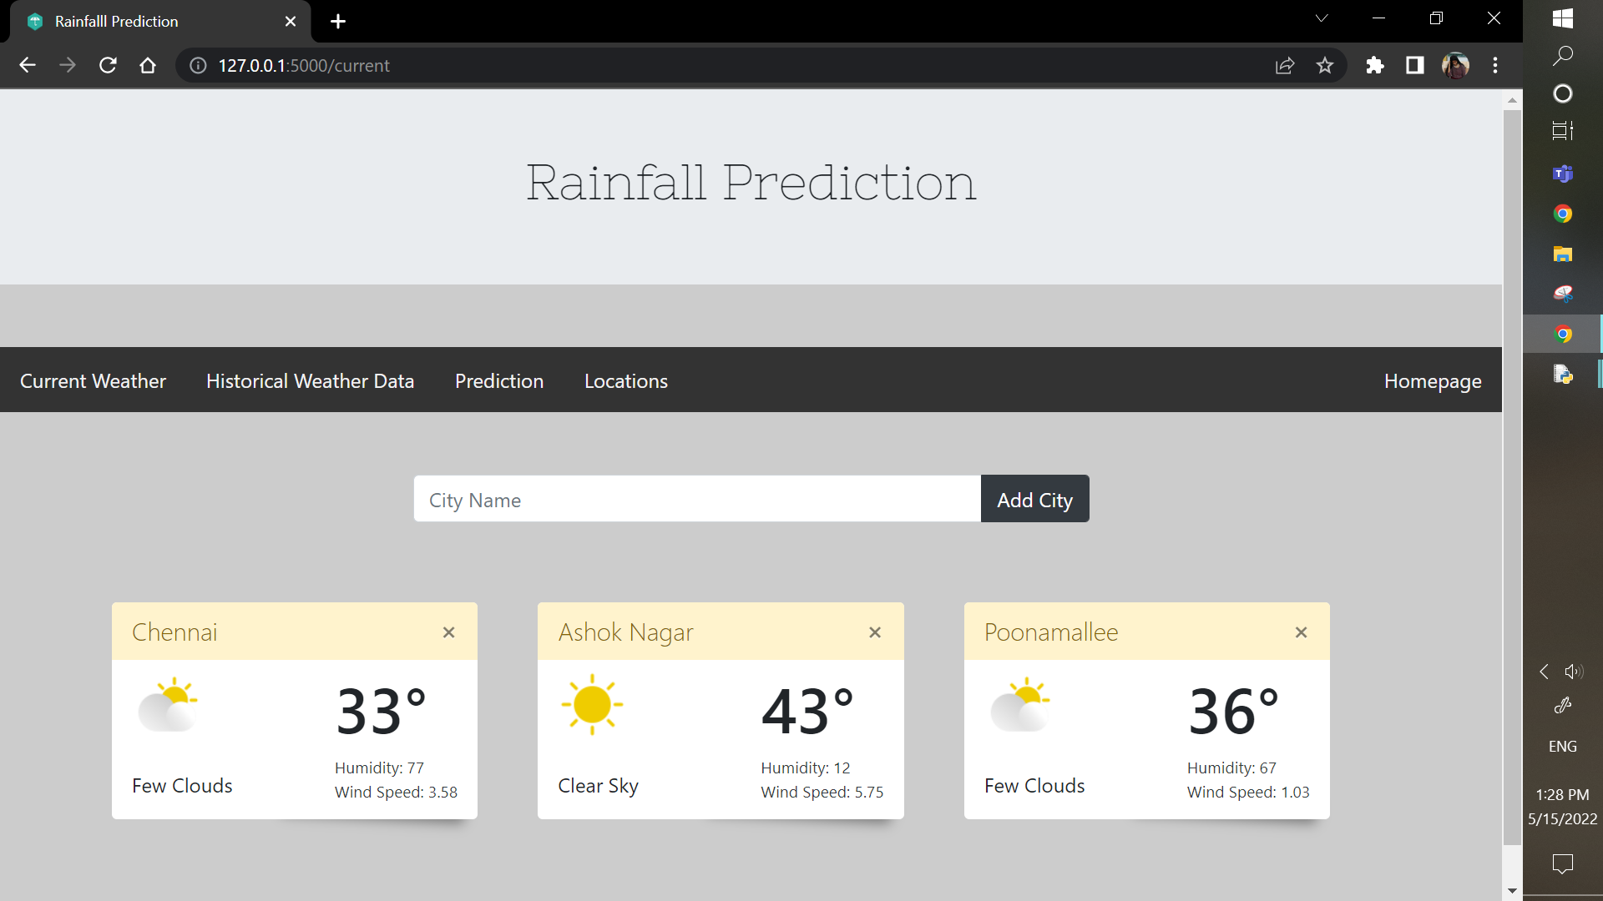
USER INTERFACE

Slide 8
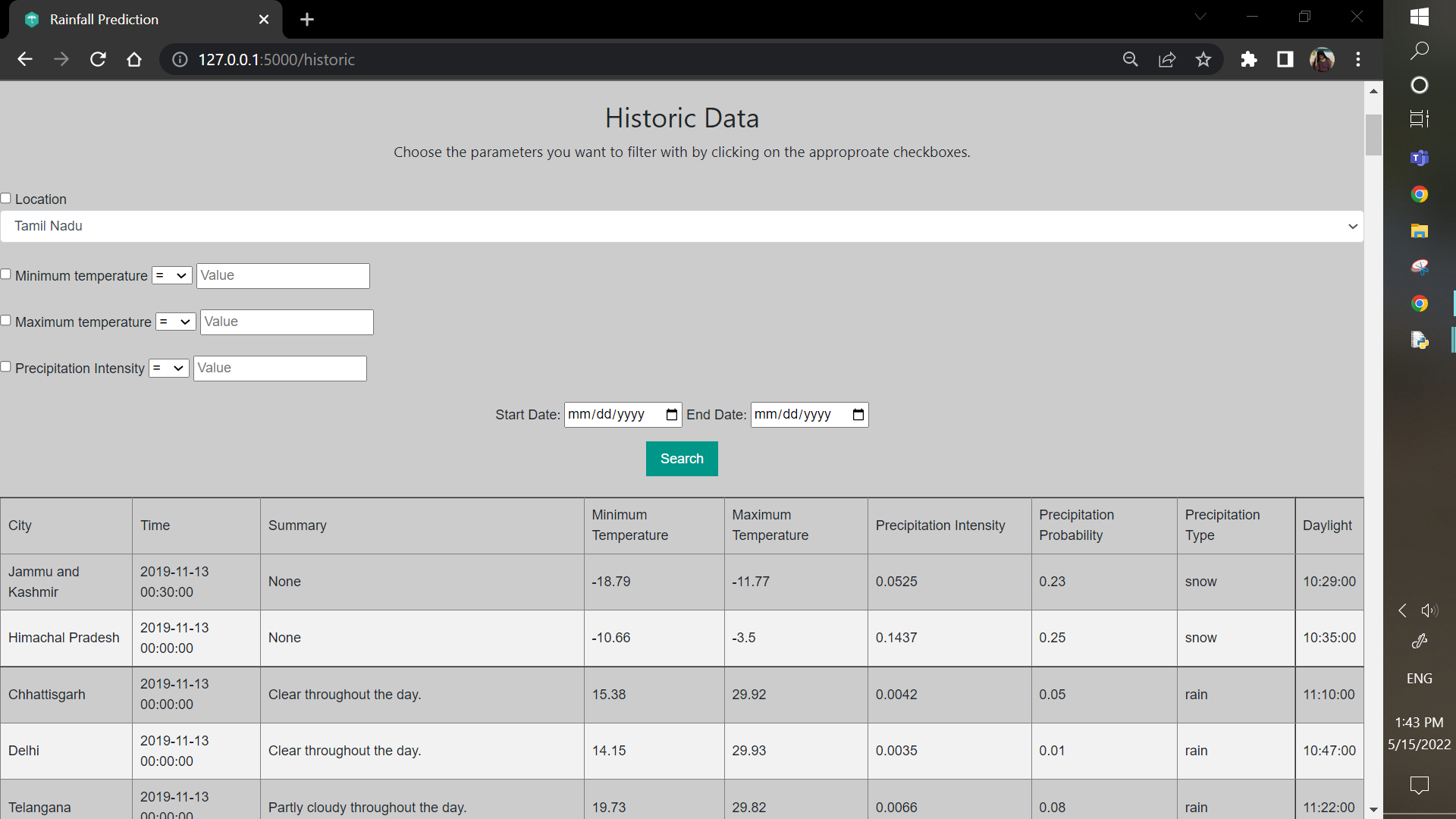
USER INTERFACE

Slide 9
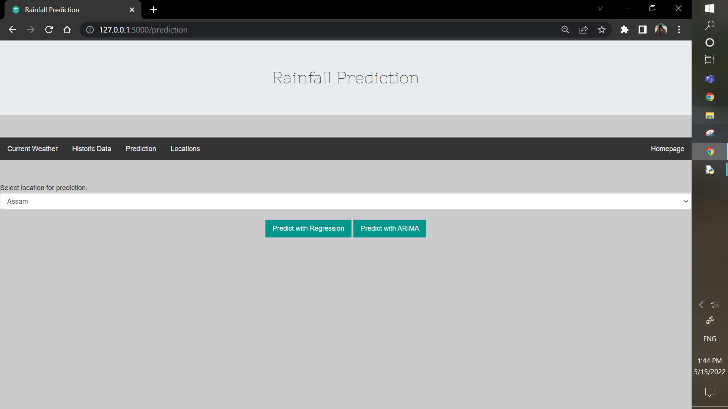
USER INTERFACE

Slide 10
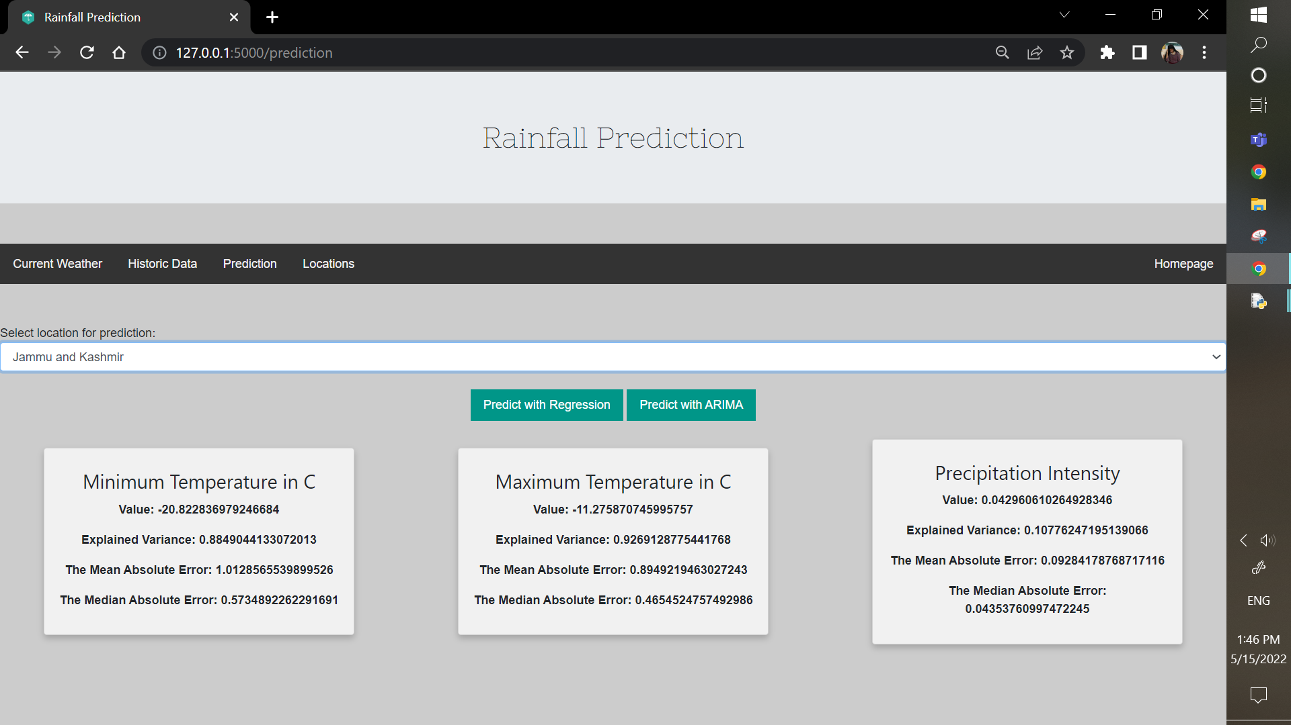
USER INTERFACE

Slide 11
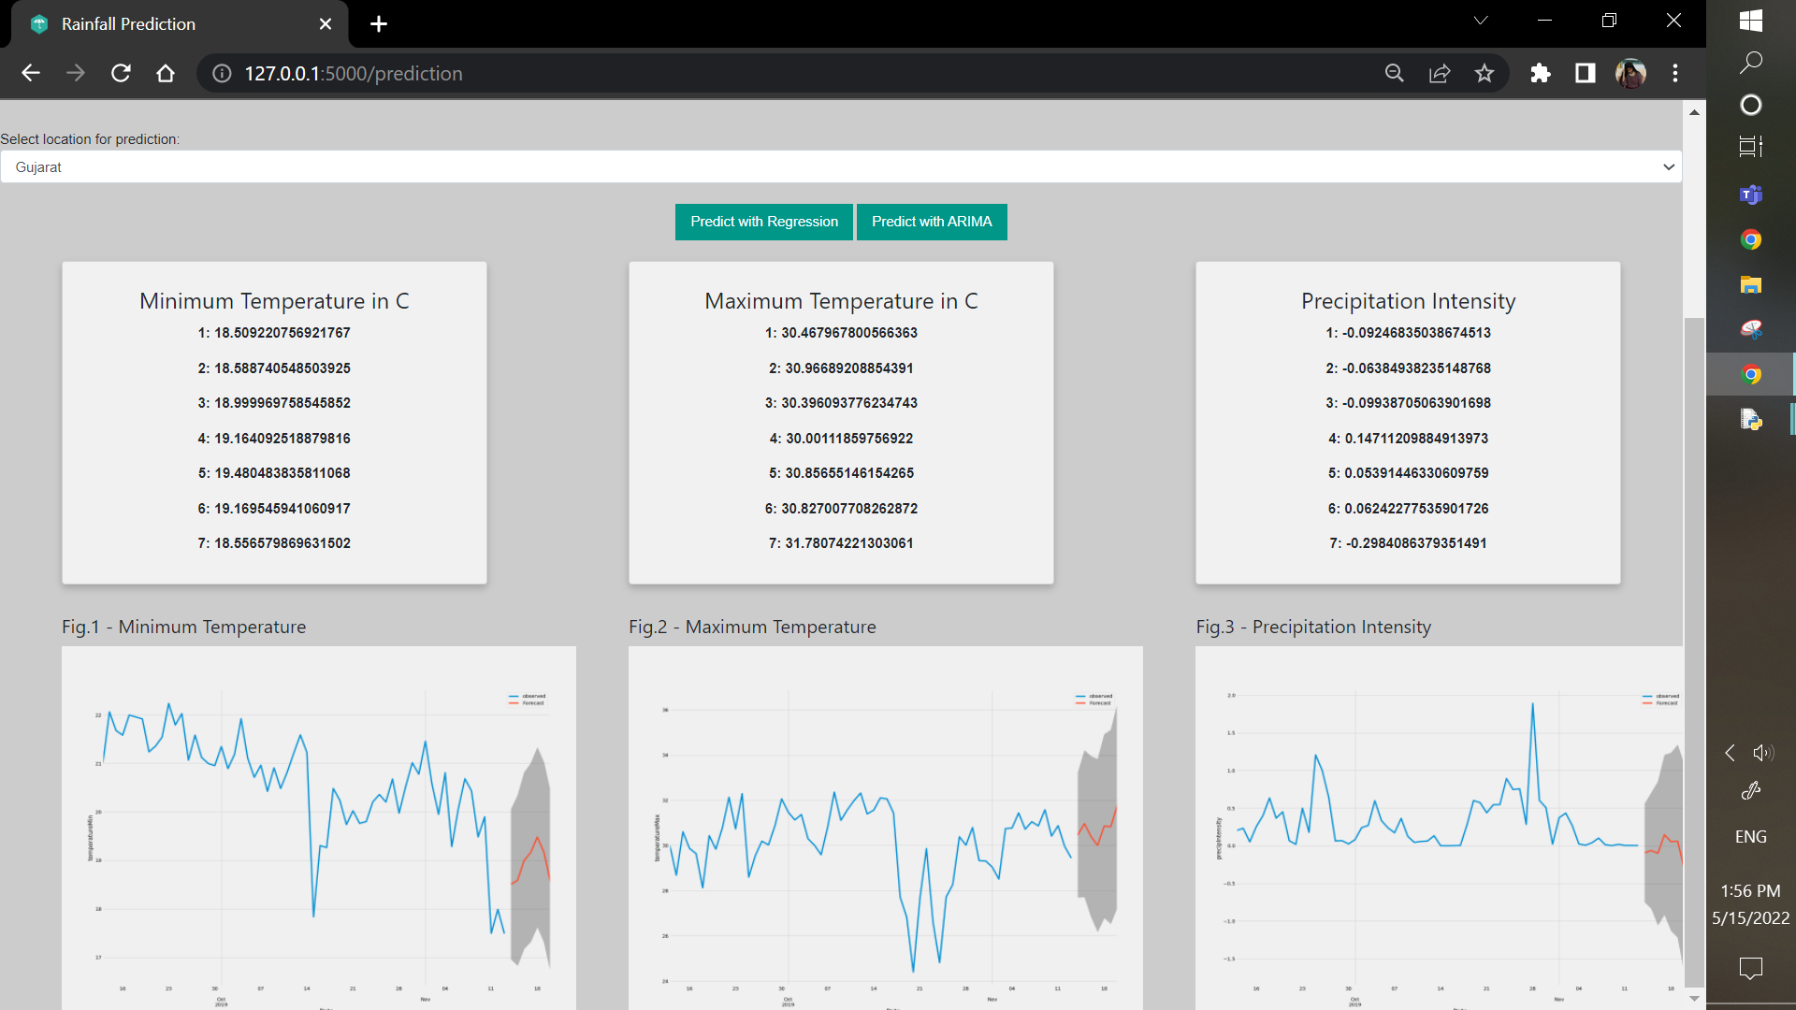
USER INTERFACE

Slide 12
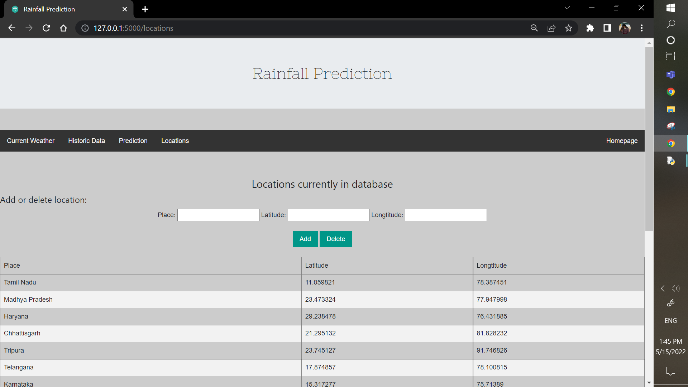
USER INTERFACE

Slide 13
MODULES
Data Collection.
Data Preprocessing.
Feature Extraction.
Linear Regression.
ARIMA (Auto Regressive Integrated Moving Average)
Ensemble Methods and Bagging.

Slide 14
DATA COLLECTION
Real time unstructured data which is been modified to structured format is collected from data.gov.in .
Collection of data is most important tasks of any machine learning projects. Because the input we feed to the algorithms is data.
So, the algorithms efficiency and accuracy depend upon the correctness and quality of data collected.
DATASETS
Link - https://data.gov.in/catalog/district-rainfall-normal-mm-monthly-seasonal-and-annual-data-period-1951-2000
File format - .xls
Data Count - 12198

Slide 15
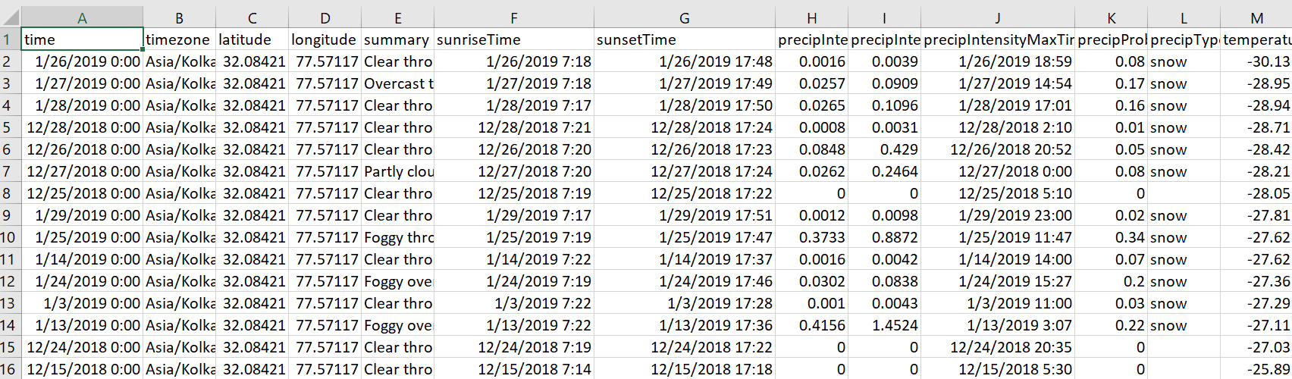
DATA PREPROCESSING
Data preprocessing is a technique that involves transforming raw data into an understandable format.
The dataset might contain empty values, negative values or error.
Dataset is cleared in preprocessing stage.
The preprocessing method involves removing records which is not complete.
So, it creates the reliable consistent data that improves the efficiency of the training data for analysis and also enables accurate decision making.

Slide 16
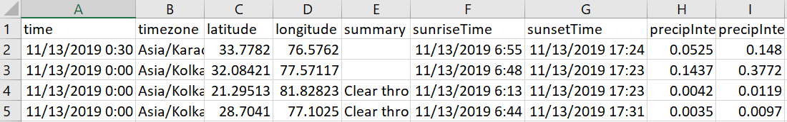
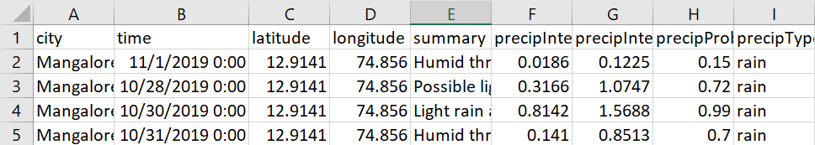
FEATURE EXTRACTION
Feature extraction is useful when we have a large dataset and need to reduce the number of resources without losing any important or relevant information.
The original dataset contains unwanted information which is not required for training the model.
So by using feature extraction process only required information is extracted from the original dataset.

Slide 17
LINEAR REGRESSION
Linear Regression is a method that describes the relationship between a dependent variable and a set of independent variables.
The equation of the line is given. It provides an estimate of rainfall using various atmospheric variables like cloud cover, humidity, wind, and average temperature to predict rainfall.
An estimate of rainfall is easy to determine at any given point since the regression method uses the previous correlation between the various atmospheric variables.

Slide 18
ARIMA
This model is used for time series prediction and analysis and forecasting. It contains four methods and is proposed by Box and Jenkins. The following are the four steps used in the ARIMA model.
Stage-1: Identification of a series of responses is done in the first stage which is used in calculating the time series and autocorrelations using statement IDENTIFY
Stage-2: In this stage Estimation of the previously identified variables is done and also the parameters are estimated using the statement ESTIMATE.
Stage-3: Diagnostics checking of the above-collected variables and parameters is done in this stage.
Stage-4: In this stage the predicting values of time series are forecasted which are future values, using the ARIMA model using the statement FORECAST.

Slide 19
ENSEMBLE METHOD AND BAGGING
Bagging is the ensemble learning method that is commonly used to reduce variance within a noisy dataset.
Ensemble learning is a machine learning paradigm where multiple models are trained to solve the same problem and combined to get better results.
Bagging generates multiple bootstrap data from the original dataset, constructs a prediction model in a uniform way for each bootstrap data, and combines the models to arrive at the final model.

Slide 20
ARIMA ALGORITHM
STEP 1: Plot rainfall data as time series.
STEP 2: Difference data to make data stationary on mean (remove trend).
STEP 3: log transform data to make data stationary on variance.
STEP 4: Difference log transform data to make data stationary on both mean and variance.
STEP 5: Plot ACF and PACF to identify potential AR and MA model.
STEP 6: Identification of best fit ARIMA model.
STEP 7: Plot ACF and PACF for residuals of ARIMA model to ensure no more information is left for extraction.

Slide 21
LINEAR REGRESSION
STEP 1: Load the data into python. Follow these four steps for each dataset.
STEP 2: Make sure your data meet the assumptions.
STEP 3: Perform the linear regression analysis.
STEP 4: Check for homoscedasticity.
STEP 5: Visualize the results with a graph.
STEP 6: Report your results.

Slide 22
REFERENCES
U.Ashwini, K.Kalaivani* , K.Ulagapriya and A.Saritha, year 2021, “Time Series Analysis based Tamilnadu Monsoon Rainfall Prediction using Seasonal ARIMA” ,IEEE, Chennai, India.
DOI:https://ieeexplore.ieee.org/document/9358615
Anosh Graham , Ekta Pathak Mishra, year 2017, “Time series analysis model to forecast rainfall for Allahabad region”, Journal of Pharmacognosy and Phytochemistry, Uttar Pradesh, India.
DOI:https://www.phytojournal.com/archives/2017/vol6issue5/PartU/6-5-80-125.pdf
Pengcheng Zhang, Yangyang Jia, Jerry Gao, Wei Song, Hareton Leung, year 2018, “Short-term Rainfall Forecasting Using Multi-layer Perceptron”, IEEE, China.
DOI: https://ieeexplore.ieee.org/document/8468083

Slide 23
REFERENCES
Nitin Singh, Saurabh Chaturvedi, Shamim Akhter, year 2019, “Weather Forecasting Using Machine Learning Algorithm”, IEEE, noida, India.
DOI:https://ieeexplore.ieee.org/document/8938211
Arnav Garg, Himanshu Pandey, year 2019, “Rainfall Prediction Using Machine Learning”, International Journal of Innovative Science and Research Technology, Kanchipuram Tamil Nadu, Volume 4, Issue 5.
DOI:https://ijisrt.com/wp-content/uploads/2019/05/IJISRT19MY198.pdf
CMAK Zeelan Basha, Nagulla Bhavana, Ponduru Bhavya, Sowmya V, year 2020, “Rainfall Prediction Using Machine Learning & Deep Learning Techniques “, International Conference on Electronics and Sustainable Communication Systems, Guntur, India.
DOI: https://ieeexplore.ieee.org/document/9155896

Slide 24
REFERENCES
Moulana Mohammed, Roshitha Kolapalli, Niharika Golla, Siva Sai Maturi, Year 2020, "Prediction Of Rainfall Using Machine Learning Techniques", international journal of scientific & technology research, volume 9, issue 01.
DOI:http://www.ijstr.org/final-print/jan2020/Prediction-Of-Rainfall-Using-Machine-Learning-Techniques.pdf
Uchamad Taufiq Anwar, Saptono Nugrohadi, Vita Tantriyati, Vikky Aprelia Windarni, year 2020, “Rain Prediction Using Rule-Based Machine Learning Approach”, Advance Sustainable Science, Engineering and Technology, Indonesia.
DOI: http://journal.upgris.ac.id/index.php/asset/article/view/6019
Wanie M. Ridwan, Michelle Sapitang, Awatif Aziz, Khairul Faizal Kushiar, Ali Najah Ahmed, Ahmed El-Shafie, year 2020,“Rainfall forecasting model using machine learning methods:Casestudy Terengganu,Malaysia”,AinShams Engineering Journal, Terengganu, Malaysia.
DOI:https://www.sciencedirect.com/science/article/pii/S2090447920302069

Slide 25
REFERENCES
Dechao Sun, Jiali Wu, Hong Huang, Renfang Wang , Feng Liang, and Hong Xinhua, year 2021, “Prediction of Short-Time Rainfall Based on Deep Learning”, Hindawi, Ningbo, China, Volume 2021, 8 pages.
DOI: https://www.hindawi.com/journals/mpe/2021/6664413/
Nana kofi ahoi appiah-badu, yaw marfo missah, leonard k. amekudzi, najim ussiph, twum frimpong, and emmanuel ahene, year 2021, “Rainfall Prediction Using Machine Learning Algorithms for the Various Ecological Zones of Ghana”, IEEE, volume 10.
DOI: https://ieeexplore.ieee.org/abstract/document/9664520

